Slide 1
Using Tables for Organization and Layout
What are the HTML Table Elements
Combining the Use of HTML Tables and CSS1 Style Sheets
Using an HTML Table to create a Layout for Links
Creating Page Columns with a Table
Controlling a Form Layout with a Table

Slide 2
What are the HTML Table Elements
Html tables begin and end with the table tags, <table> and </table>
They contain rows, defined with the row tags <tr> and </tr>.
Cells defined with cell tags, <td> and </td>
Captions for tables are created with the begin and end caption tags, <caption> and </caption>.
Some cells can be designated as table row headers with the use of the <th> and </th> tags.

Slide 3
What are the HTML Table Elements
The basic Table Elements
Attribute | Description
Align | How table aligns with other elements.
Bgcolor | Background color for table
Width | Width of table
Cols | Number of columns within table.
Border | Width in pixels of frame around table.
Frame | Which sides of the frame surrounding table are visible.
Rules | Which rules appear between table columns and rows
Cellspacing | The space between cell border and table frame.
Cellpadding | The space between cell border and cell contents.

Slide 4
What are the HTML Table Elements
The frame attribute has several values.
Void – no frame
Above – top side only
Below – bottom side only
Hsides – horizontal sides
Vsides – vertical sides only
Lhs – left side only
Rhs – right side only
Box – all four sides
Border – all four sides

Slide 5
What are the HTML Table Elements
The acceptable values for the rules attribute
None – no rules
Groups – rules appear only between groups
Rows – rules appear between rows
Cols – rules appear between columns
All – rules appear between all elements.

Slide 6
What are the HTML Table Elements
TH and TD element attributes
Attribute | Description
Nowrap | Disbale automatic text wrapping
Bgcolor | Background color of cell
Rowspan | Numbers of rows spanned by cell
Colspan | Number of columns spanned by cell.

Slide 7
Column Grouping with COLGROUP and COL
The columns of the table can be grouped by using the colgroup element.
Once grouped, you can apply a width to all of the columns included within the group.
A second element col, can also supply specific width and alignment information for one or more columns within the group.
Example
<table border="1">
<colgroup span="3">
<col width="50"></col>
<col width="100"></col>
<col width="20"></col>
</colgroup>
<tr>
<td>col 1</td>
<td>col 2</td>
<td>col 3</td>
</tr>
</table>

Slide 8
Row Grouping with thead, tfoot and tbody elements
Each table has at least one row, and this becomes the default table body.
However, the rows that make up the body can also be delimited with one or more tbody elements.
The rows that make up the table head for a specific row grouping can be delimited with the thead element.
The foot of the table row grouping can be delimited with the tfoot element.

Slide 9
Row Grouping with thead, tfoot and tbody elements
Example
<table width=60% frame=border border=8 rules=groups cols=3 cellspacing=3 cellpadding=5 align=center>
<caption> This is an example table </caption>
<thead align=left>
<tr>
<th> </th>
<th> second Value </th>
<th> Third Value </th> </tr>
<tfoot>
<tr> <td> Month Two Subtotals </td>
<td> 1446 </td>
<td> 18889 </td>
</tr>
</tfoot>
<tbody>
<tr>
<td rowspan=2> Month One Values: </td>
<td> 0.5 </td>
<td> .5 </td>
</tr>
<tr><td> 4.4 </td>
<td> 89.3 </td>
</tr>

Slide 10
Row Grouping with thead, tfoot and tbody elements
<tfoot>
<tr>
<td> Month one Subtotals : </td>
<td> 1 </td>
<td> 1 94 </td>
</tr>
<tbody>
<tr>
<td rowspan=2> Month One Values: </td>
<td> 1.444 </td>
<td> .0005 </td>
</tr>
<tr><td> 1444.444 </td>
<td> 18889.003 </td>
</tr>
</tbody>
</table>

Slide 11
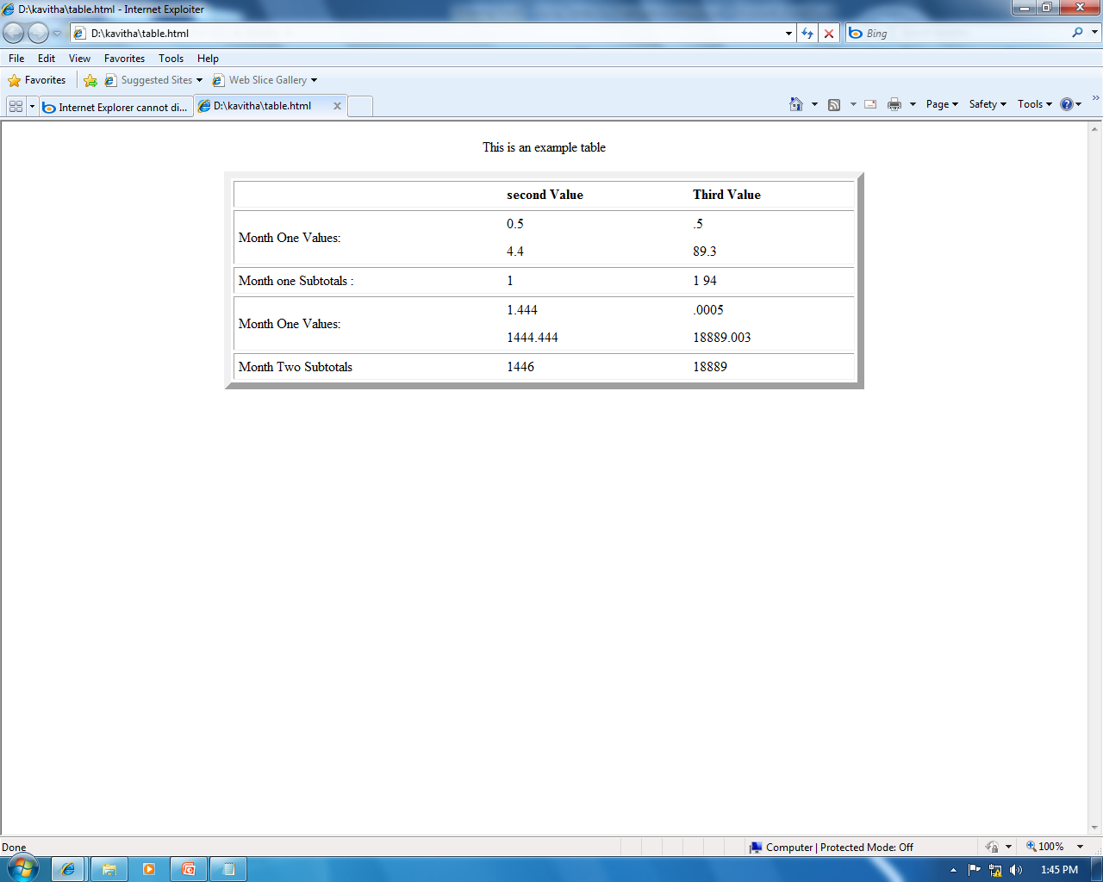

Slide 12
Combining the Use of HTML Tables and CSS1 Style Sheets
<head>
<style type=“text/css”>
Thead { background-color: red; color: yellow}
Tbody { background-color:black ; color: yellow}
Tfoot { background-color:lime; color: yellow}
Table { border-style: groove; border-color:blue;
color: darkgreen;
Th { font-family : fantasy }
</style>

Slide 13
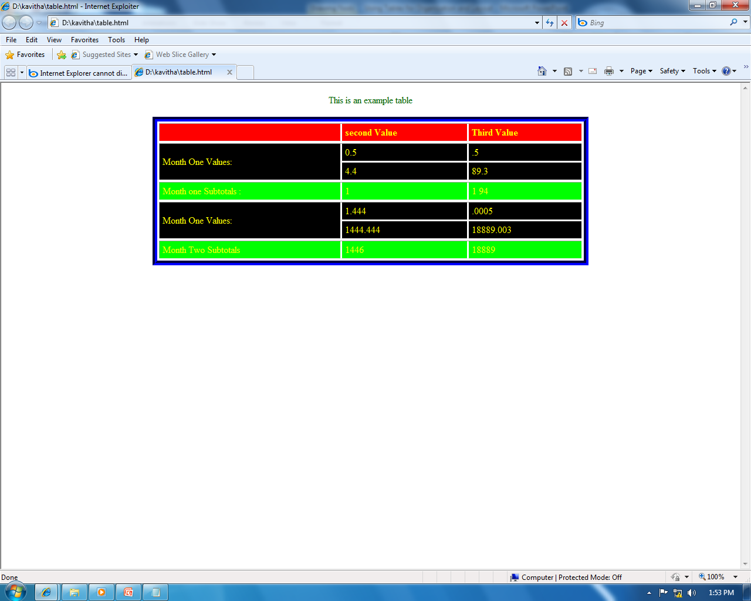
Combining the Use of HTML Tables and CSS1 Style Sheets

Slide 14
Using an html table to create a Layout for Links
A popular use of html tables is to maintain the layout of a links page or a section of a page that contains resource links
One column table used to control layout of a links list.
Example
<html>
<body>
<table width=80% cellpadding=10 cellspacing=15 border=5 frame=border rules=none align=center>
<caption align=bottom> Internet Explorer Dynamic Html Links </caption>
<tr> <td> <h1> My IE Dynamic Html Resources </h1> </td> </tr>
<tr><td> <a href="http://www.w3.org/pub/www/tr/wd-positioning"> W3C Positioning Draft </a> </td></tr>
<tr><td> <a href="http://www.microsoft.com/ie/ie40"> Internet Explorer 4.0 Platform Preview </a> </td></tr>
</table>
</body>
</html>

Slide 15
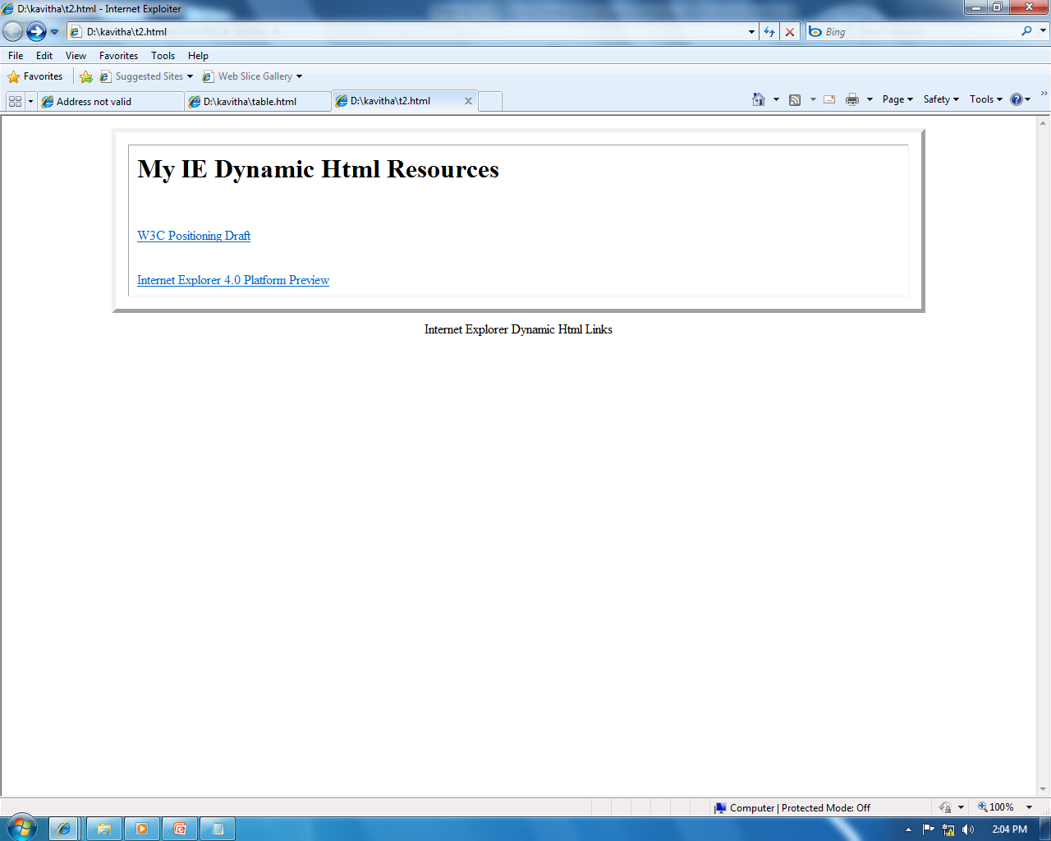
Using an html table to create a Layout for Links

Slide 16
Creating Page Columns with a Table
Another popular use of html tables is to create columns within a page.
<table width=100% cols=3 cellspacing =10>
<colgroup span=3>
<col width=“30%”>
<col width=“35%”>
<col width=“35%”>

Slide 17
Controlling a Form Layout with a Table
With a table, the form elements can be easily aligned.
Example…

